Slide 1

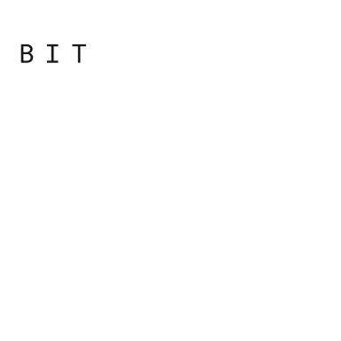
Programming
Principles
with JavaScript

Slide 2
Conditions

Slide 3

Conditions
Conditions provide a simple but powerful way to control the flow of code execution
var result = '';
var a = 3;
if (a > 2) {
result = a + ' is greater than 2';
}
console.log(result);
// Output: 3 is greater than 2

Slide 4
Conditions
The parts of the if condition are:
The if statement
A condition in parentheses ()
A block of code wrapped in {} that executes if the condition is satisfied

Slide 5
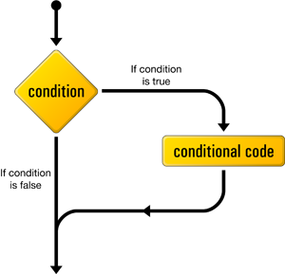

Slide 6
Conditions
The condition (the part in parentheses) always returns a Boolean value
A logical operation: !, &&, or ||
A comparison, such as ===, !=, >
Any value or variable that can be converted to a Boolean
A combination of the above

Slide 7
Conditions
Optional else part of the if condition
The else statement is followed by a block of code that runs if the condition evaluates to false

Slide 8
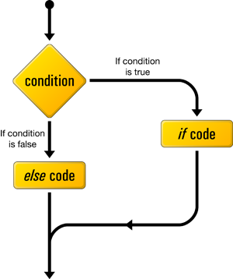

Slide 9
Conditions
var result = '';
var a = 3;
if (a > 2) {
result = a + ' is greater than 2';
} else {
result = a + ' is NOT greater than 2';
}
console.log(result);
// Output: 3 is greater than 2

Slide 10
Conditions
var result = '';
var a = 1;
if (a > 2) {
result = a + ' is greater than 2';
} else {
result = a + ' is NOT greater than 2';
}
console.log(result);
// Output: 1 is NOT greater than 2

Slide 11
Conditions
In between the if and the else, there can also be an unlimited number of else if conditions.
var result = '', a = 0, b = 1;
if (a > 2 || a < -2) {
result = 'a is not between -2 and 2';
} else if (a === 0 && b === 0) {
result = 'both a and b are zeros';
} else if (a === b) {
result = 'a and b are equal';
} else {
result = 'I give up';
}
console.log(result);

Slide 12
Conditions
var result = '', a = 0, b = 1;
if (a === 1) {
if (b === 2) {
result = 'a is 1 and b is 2';
} else {
result = 'a is 1 but b is not 2';
}
} else {
result = 'a is not 1, no idea about b';
}
console.log(result);

Slide 13
Checking if a Variable Exists
It's often necessary to check whether a variable exists
var result = '';
if (somevar) {
result = 'yes';
}
// ReferenceError: somevar is not defined
Notes:
The code generated an error: somevar is not defined, and you don't want your code to behave like that. Second, just because if (somevar) returns false, doesn't mean that somevar is not defined. It could be that somevar is defined and initialized, but contains a falsy value like false or 0.

Slide 14
Checking if a Variable Exists
A better way to check if a variable is defined is to use unary operator typeof
typeof always returns a string, and you can compare this string with the string "undefined"
var result = "";
if (typeof somevar !== "undefined") {
result = "yes";
}
console.log(result);
// Output: ""

Slide 15
Ternary Operator
(condition) ? value1 : value2
is called a ternary operator because it takes three operands.It is usually denoted as ?:

Slide 16

Practical
Notes:
Starting with the bootcamp
Hoping to catch the wave and achieve much more

Slide 17
Write a program that compares two numbers and display the larger. Result should be displayed in the console.

Slide 18
Write a program to check if the number is divisible by 2. If it is, print even, if not, print odd.
Sample numbers: 3, 4, 9 (check one at the time)
Output: odd, even, odd

Slide 19
Write a program to check if the number is divisible by 3 and 5. If it is, print that number.
Sample numbers: 15, 12 (check one at the time)
Output: 15

Slide 20
Write a conditional statement to find the sign of product of three numbers. Display the result in the console with the specified sign.
Sample numbers: 3, -7, 2
Output: The sign is -

Slide 21
Write a program to check if the variable is a number. If it’s a number, check if it is divisible by 2. If it is, print the result, if not, show “X”
Sample numbers: 10 | 7 (check one at the time)
Output: 10 / 2 = 5 | X

Slide 22
Write a conditional statement to find the largest of five numbers. Display the result in console.
Sample numbers: -5, -2, -6, 0, -1
Output: 0

Slide 23
Write a conditional statement to sort three numbers.
Sample numbers : 0, -1, 4
Output : 4, 0, -1

Slide 24

Notes:
http://eloquentjavascript.net/01_values.html

